Slide 1
Lecture 4 Switch Debouncing
Course Teacher: DEBRAJ DAS

Slide 2
What is Debouncing?
When the state of a mechanical switch is changed from open to closed and vice versa, there is often a short period of time when the input voltage jumps between HIGH and LOW levels a couple of times before it settles. These transitions are called bouncing and getting rid of the effect of these transitions is called debouncing. To apply a manual switch signal into a digital circuit, we need to debounce the signal, so a single press doesn’t appear as multiple presses.
Alternatively, when a mechanical switch is flipped/pressed, the metal contacts inside may not open or close cleanly. In the microseconds before the switch achieves a good solid connection, the switch's contacts may "bounce" against each other, turning the switch on and off in rapid succession.

Slide 3
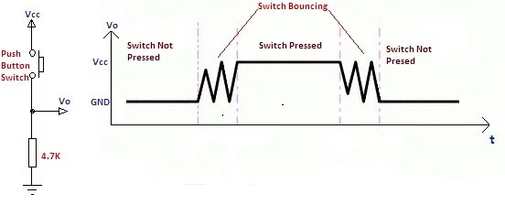
Why does Bouncing Happen?
Bouncing is a result of the physical property of mechanical switches.
Switch and relay contacts are usually made of metallic springs so when a switch is pressed, it is essential that two metal parts come together. But, this does not happen immediately, it bounces between in-contact (close the contact) and not-in-contact (open the contact) until it finally settles down.
Figure shows a simple push switch with a pull-down resistor and at its right, the output signal, V_{out} shows the signal bounces when the switch is pressed or depressed.
Pull-down Resistor

Slide 4
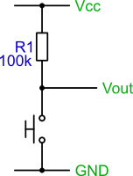
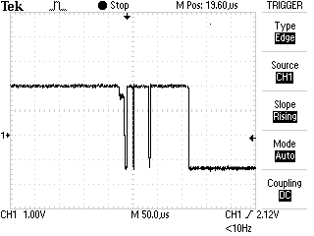
Why does Bouncing Happen?
Figure shows a simple push switch with a pull-up resistor and at its right side, the trace shows the output signal, V_{out}, when the switch is pressed. As can be seen, pressing the switch does not provide a clean edge. If this signal is used as an input to a digital counter, for example, you will get multiple counts rather than the expected single count.
The same can also occur on the release of a switch.
The problem is that the contacts within the switch don't make contact cleanly, but slightly 'bounce'. The bounce is quite slow, so you can recreate the trace, and the problem quite easily.
Pull-up Resistor

Slide 5
Why does Bouncing Happen?
The bouncing phenomenon is associated with the Single Pole Single Throw (SPST), Single Pole Double Throw (SPDT), and similar other types of toggle switches. The bouncing case data may be analyzed to see how long the switch bounce persists, how wide the individual bounce pulses are, and how many bounces are observed.
It is essential that the technique is not fooled by the occasional noise “glitch” or “spike” caused by other electrical, electronic, or electromagnetic signals, such as
Crosstalk,
EMI (electromagnetic interference)
RFI (radio frequency interference)
ESD (electrostatic discharge).

Slide 6
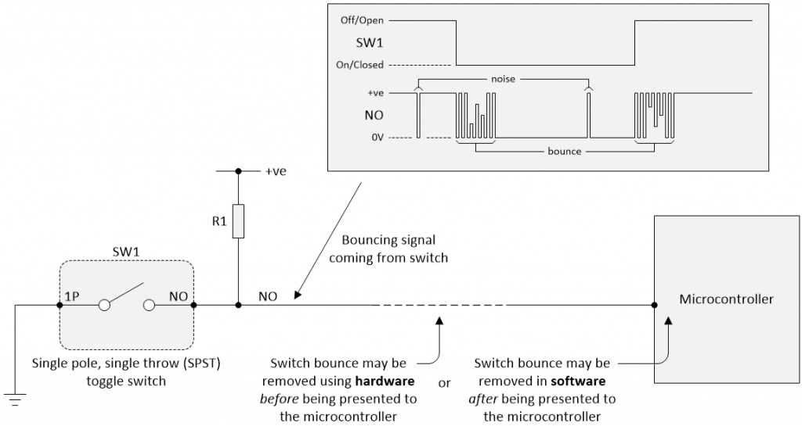
How does Bouncing Happen?
In this diagram, resistor R₁ is acting as a pull-up resistor.
When the switch is open, R₁ pulls the NO (Normally Open) contact to a positive (logic 1) value, usually +5 V.
When the switch is closed, it shorts the NO contact to 0 V (logic 0).
We intend to get an output voltage of 5 V (logic 1) when the switch is not pressed, and 0 V (logic 0) when it is pressed.
But before the signal settles, it bounces between the two logic states several times.

Slide 7
How to Avoid Bouncing?
The digital circuits and microcontrollers don’t like its input signals wandering around the undefined region between a “good” logic 0 and a “good” logic 1.
A standard buffer has single switching threshold, so a noisy signal or a signal with a bit of ripples on it, can result in multiple transitions at the output.
In 1934, a young graduate student named Otto Herbert Schmitt invented a circuit known as the Schmitt trigger (this invention was a result of Otto’s study into the propagation of neural impulses in the nerves of squids- a kind of sea fish) that has two thresholds. The output changes only when the input crosses the upper threshold (during upward transition) or the lower threshold (during downward transition) . This dual-threshold action is called hysteresis (the dependence of the state of a system on its history), which implies that the trigger possesses memory.

Slide 8
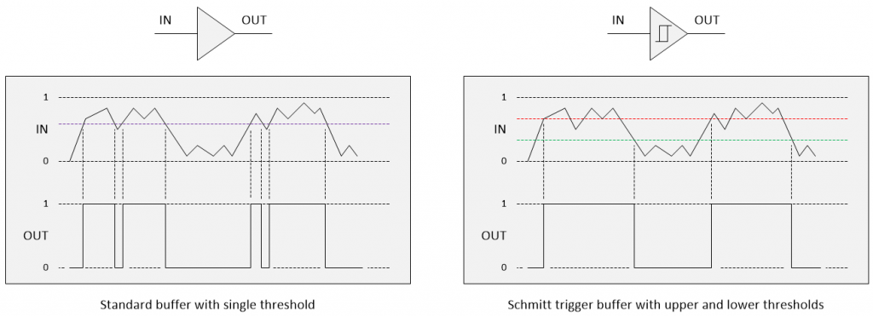
How to Avoid Bouncing?
Single threshold
Dual thresholds
Hysteresis

Slide 9
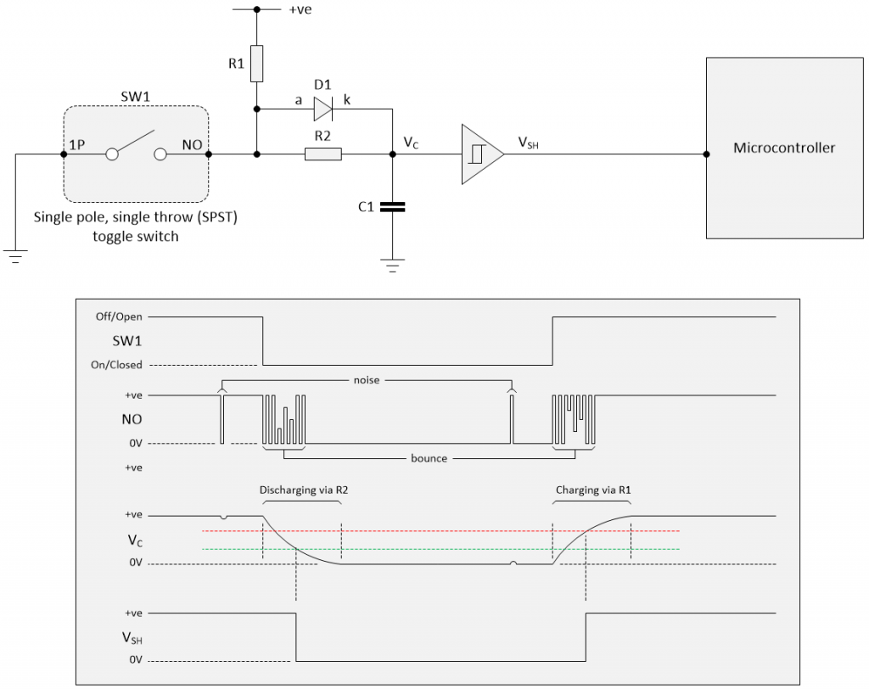
How to Avoid Bouncing?
In the RC network, we use a simple SPST switch debounce circuit, we would add a Schmitt trigger buffer between the RC network and the microcontroller as illustrated below.

Slide 10
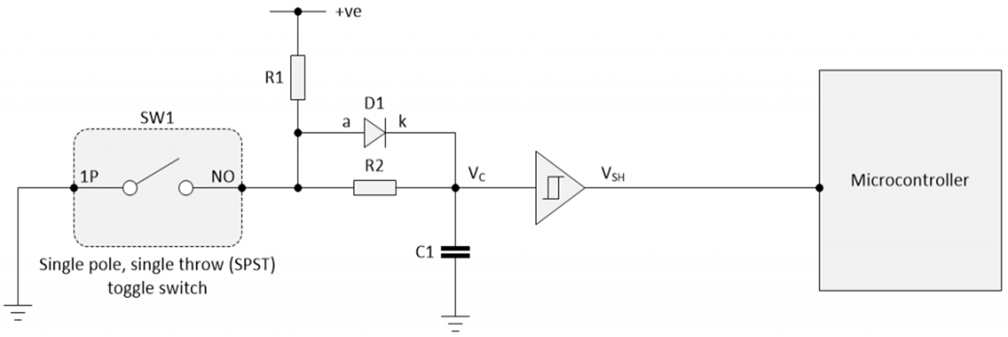
How to Avoid Bouncing?
1. When Switch is OPEN
The capacitor charges through the resistor.
The voltage across the capacitor gradually rises to the supply voltage (e.g., +5V).
The Schmitt Trigger input sees a steady HIGH signal (no bounce).
2. When Switch is CLOSED
The switch shorts the capacitor to ground (0 V).
The capacitor discharges through the resistor, pulling the voltage slowly down instead of instantly jumping.
This smooth transition prevents multiple logic changes.
The Schmitt Trigger then converts this slow falling voltage into a clean LOW output.
Role of the Schmitt Trigger
The RC network removes short, rapid fluctuations (hardware filtering).
The Schmitt Trigger ensures that the remaining signal switches cleanly and only once — thanks to its hysteresis property.
Without it → the capacitor voltage might stay in an undefined region (not 0 V or 5 V).
With it → the circuit ensures a sharp digital output (either fully LOW or fully HIGH).

Slide 11
How to Avoid Bouncing?
We have shown a non-inverting Schmitt trigger buffer to keep things simple.
It is common to use an inverting Schmitt trigger buffer because inverting functions are faster than their non-inverting counterparts.

Slide 12
Types of Debouncing
We can remedy this problem by debouncing the switch. There are many ways to do this. There are two general ways of getting rid of the bounces:
Hardware debouncing: adding circuitry that gets rid of the unwanted transitions.
Software debouncing: adding code/program that causes the application to ignore the bounces.
Besides, we can debounce the signals using the following techniques as well
Digital Switch Debouncing: achieved in the same way as the software approaches
Switch Debouncer using VHDL: The VHDL entity description is used.

Slide 13
Hardware Debouncing
There are various implementations of circuits that can be used for eliminating the effect of switch debouncing right at the hardware level.
One of the most popular solutions using hardware is to employ a resistor/capacitor network with a time constant (τ) longer than the time it takes the bouncing contacts to stop, i.e., τ > t_{bounce}.
Often it is also followed by a Schmitt trigger to get rid of the capacitor voltage values midway between HIGH and LOW logic.
If we wish to preserve program execution cycles, the best way is to use the hardware debouncing approach.
In hardware debouncing, we may use a flip-flop to ‘latch’ the signal, using a capacitor to absorb the bouncing periods.

Slide 14
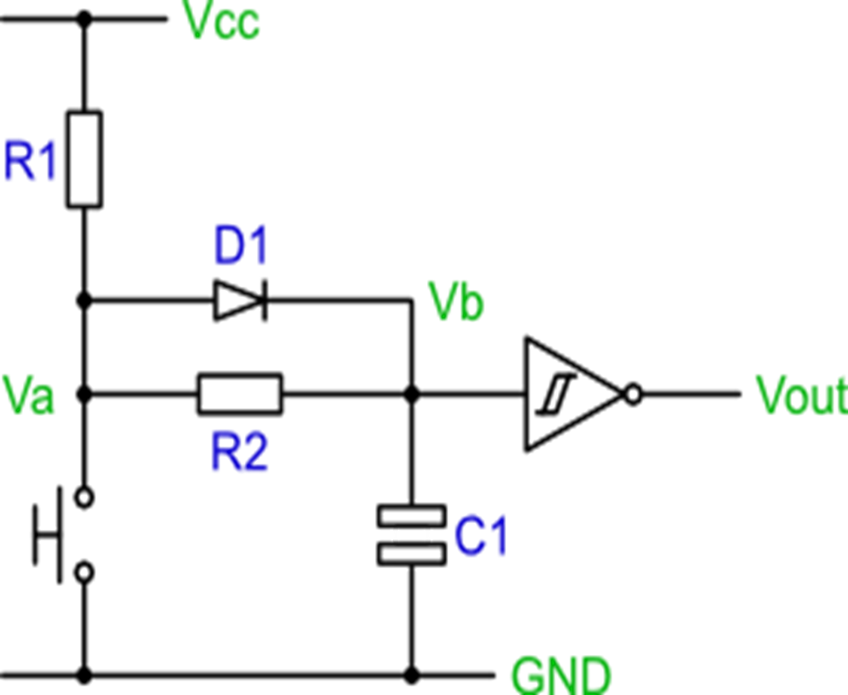
Hardware Debouncing Circuit
The following circuit is a simple hardware debouncing circuit with a switch for digital logic. When the switch is closed, the voltage is pulled down LOW through the switch, and when the switch is open, the output voltage is pulled up HIGH through the resistors R1 and R2. The resistor R2 prevents a short circuit when the switch is closed.
The capacitor absorbs the bounces when the switch changes states. Keep in mind that this circuit will cause a short delay in switching because the capacitor takes time to charge and discharge through the resistors.
The delay can be minimized by varying the values of the capacitor and resistor, but if the resistor is too small, it may not be sufficient to absorb the bounces.

Slide 15
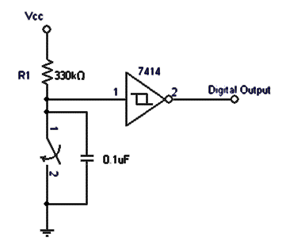
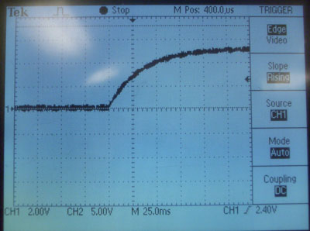
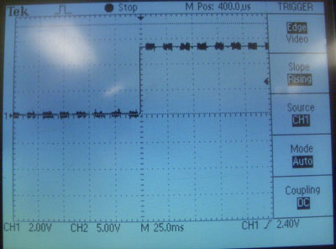
Hardware Debouncing Circuit
It is to be noted that the capacitor exhibits a curve when charging, and parts of this curve fall in the region where the logic circuit is undecided whether to treat it as a HIGH or LOW signals. To fix this problem, a Schmitt trigger is added to the output of the RC network.
Without Schmitt trigger RC network output
With Schmitt trigger digital output
RC network output
Remember that the 7414 Schmitt trigger will invert the signal.

Slide 16
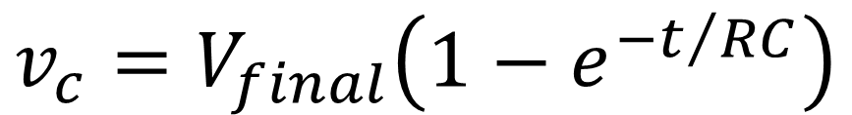
Hardware Debouncing
Circuit Design using the IC 7414 is a Schmitt trigger (inverting type buffer) with the input hysteresis.
A CMOS device like the 74AHCT14 dribbles about a μA from the inputs.
Resistances R₁ and R₂ control the capacitor’s charging-discharging time and thus set the debounce period for the switch open state.
The equation for charging is:
$$v_{c}=V_{final}\left(1−e^{−t/{RC}}\right)$$
$V_{final}$is the voltage towards which the capacitor will reach after the capacitor is completely charged. This is the supply voltage, $V_{CC}$in this case.

Slide 17
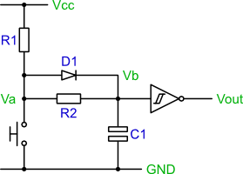
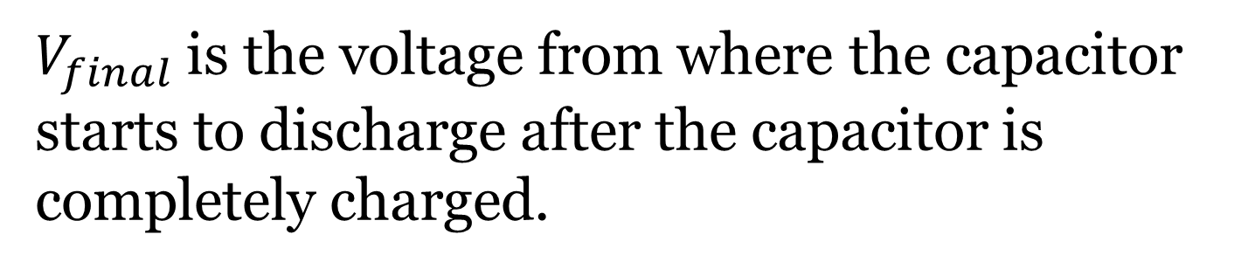

Hardware Debouncing Circuit Design
The equation for discharging a capacitor is given by
$$v_{c}=v_{th}=V_{final}e^{−t/{RC}}$$
$V_{final}$is the voltage from where the capacitor starts to discharge after the capacitor is completely charged.
Debouncing circuit design using the IC 7414 Schmitt trigger (inverting type buffer)

Slide 18
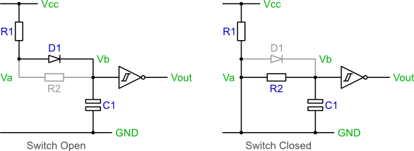
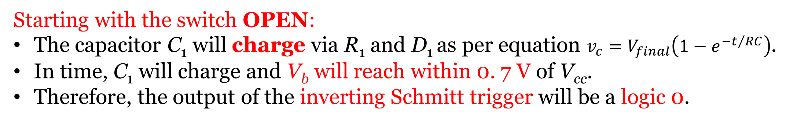
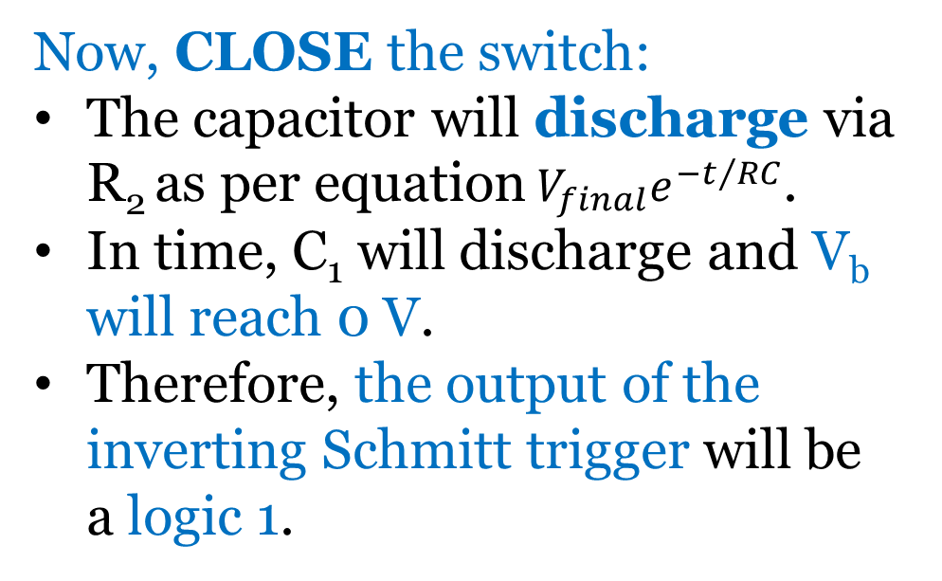
Hardware Debouncing Circuit Operation
The circuit’s operation can be explained by looking at the equivalent circuits formed in the two switching states, e.g., open and closed.
Starting with the switch OPEN:
The capacitor C₁ will charge via R₁ and D₁ as per equation $v_{c}=V_{final}\left(1−e^{−t/{RC}}\right)$.
In time, C₁ will charge and V_{b} will reach within 0. 7 V of V_{cc}.
Therefore, the output of the inverting Schmitt trigger will be a logic 0.
Now, CLOSE the switch:
The capacitor will discharge via R₂ as per equation${ V}_{final}e^{−t/{RC}}$.
In time, C₁ will discharge and V_{b} will reach 0 V.
Therefore, the output of the inverting Schmitt trigger will be a logic 1.

Slide 19
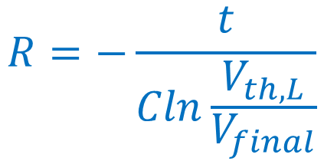
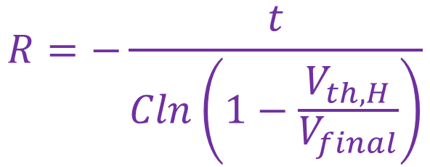


Hardware Debouncing Circuit Design
The goal of the debouncing circuit design is to select R-C values that ensure the capacitor’s voltage stays above the threshold voltage, V_{th} around which the signal switches till the switch stops bouncing.
Most of the switches exhibit bounce times well under 10 ms, making the use of this value a conservative choice.
To calculate the R-C values considering this bounce time, we rearrange the capacitor’s charging-discharging formula as follows to solve for R (the cost and size of capacitors vary widely, so it is the best option to select a value for C arbitrarily and then compute R)
$$v_{c}=v_{th,L}=V_{final}e^{−t/{RC}}$$
$$v_{c}=v_{th,H}=V_{final}\left(1−e^{−t/{RC}}\right)$$
$$R=−\frac{t}{Cln\left(1−\frac{V_{th,H}}{V_{final}}\right)}$$
$$R=−\frac{t}{Cln\frac{V_{th,L}}{V_{final}}}$$

Slide 20
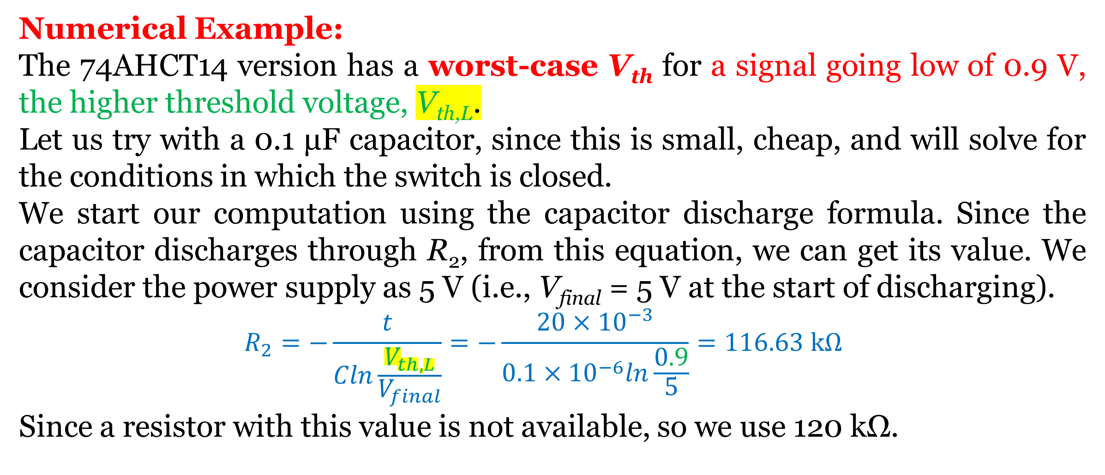
Hardware Debouncing Circuit Design
Numerical Example:
The 74AHCT14 version has a worst-case V_{th} for a signal going low of 0.9 V, the higher threshold voltage, V_{th,L}.
Let us try with a 0.1 μF capacitor, since this is small, cheap, and will solve for the conditions in which the switch is closed.
We start our computation using the capacitor discharge formula. Since the capacitor discharges through R₂, from this equation, we can get its value. We consider the power supply as 5 V (i.e., V_{final} = 5 V at the start of discharging).
$$R_{2}=−\frac{t}{Cln\frac{V_{th,L}}{V_{final}}}=−\frac{20×{10}^{−3}}{0.1×{10}^{−6}ln\frac{0.9}{5}}=116.63 kΩ$$
Since a resistor with this value is not available, so we use 120 kΩ.
Considering bounce times as 20 ms

Slide 21
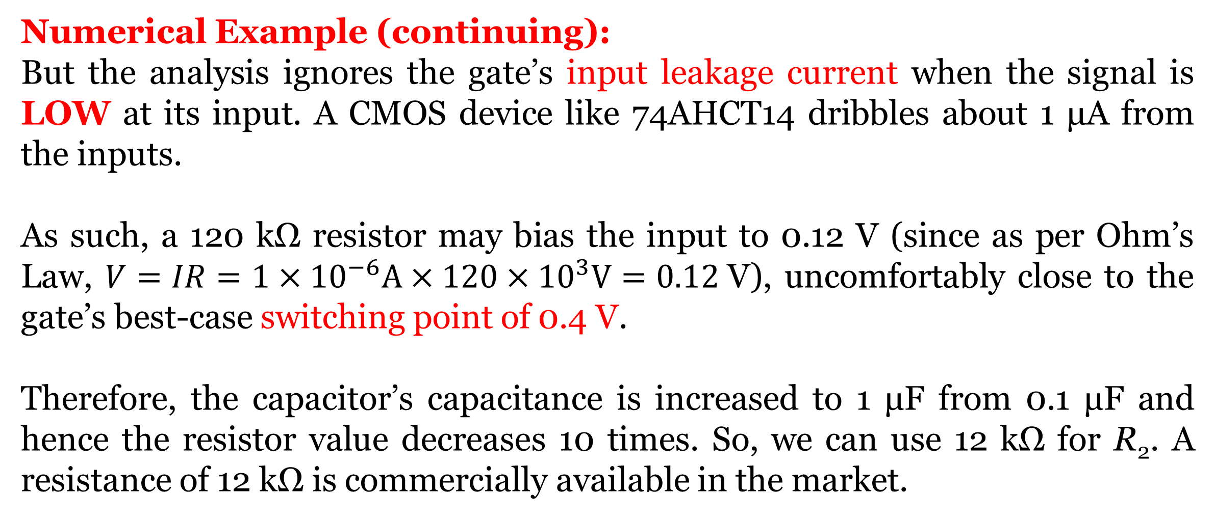
Hardware Debouncing Circuit Design
Numerical Example (continuing):
But the analysis ignores the gate’s input leakage current when the signal is LOW at its input. A CMOS device like 74AHCT14 dribbles about 1 μA from the inputs.
As such, a 120 kΩ resistor may bias the input to 0.12 V (since as per Ohm’s Law, $V=IR=1×{10}^{−6}A×120×{10}^{3}V=0.12$V), uncomfortably close to the gate’s best-case switching point of 0.4 V.
Therefore, the capacitor’s capacitance is increased to 1 μF from 0.1 μF and hence the resistor value decreases 10 times. So, we can use 12 kΩ for R₂. A resistance of 12 kΩ is commercially available in the market.

Slide 22
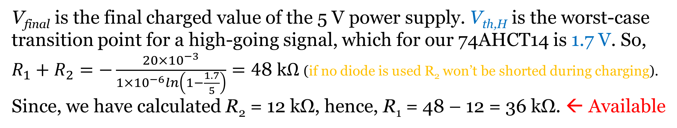
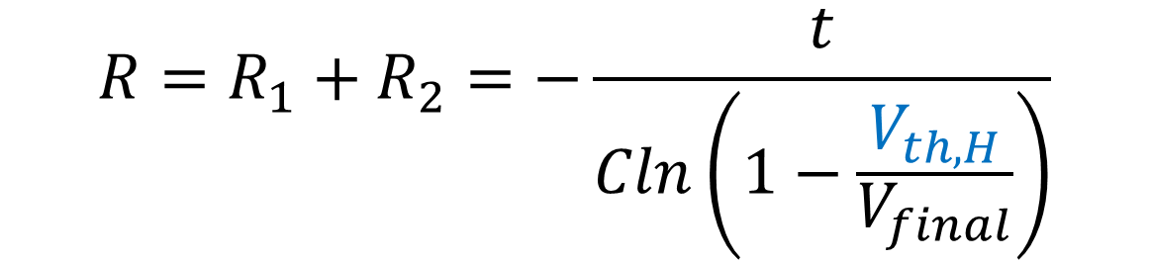

Hardware Debouncing
Numerical Example (continuing):
R₁ + R₂ controls the capacitor’s charging time and so sets the debounce period for the condition when the switch opens. The equation for charging is:
$$v_{c}=V_{final}\left(1−e^{−t/{RC}}\right)$$
Solving for R:
$$R=R_{1}+R_{2}=−\frac{t}{Cln\left(1−\frac{V_{th,H}}{V_{final}}\right)}$$
V_{final} is the final charged value of the 5 V power supply. V_{th,H} is the worst-case transition point for a high-going signal, which for our 74AHCT14 is 1.7 V. So, $R_{1}+R_{2}=−\frac{20×{10}^{−3}}{1×{10}^{−6}ln\left(1−\frac{1.7}{5}\right)}=\text{4}\text{8} kΩ$ (if no diode is used R₂ won’t be shorted during charging).
Since, we have calculated R₂ = 12 kΩ, hence, R₁ = 48 – 12 = 36 kΩ. ← Available

Slide 23
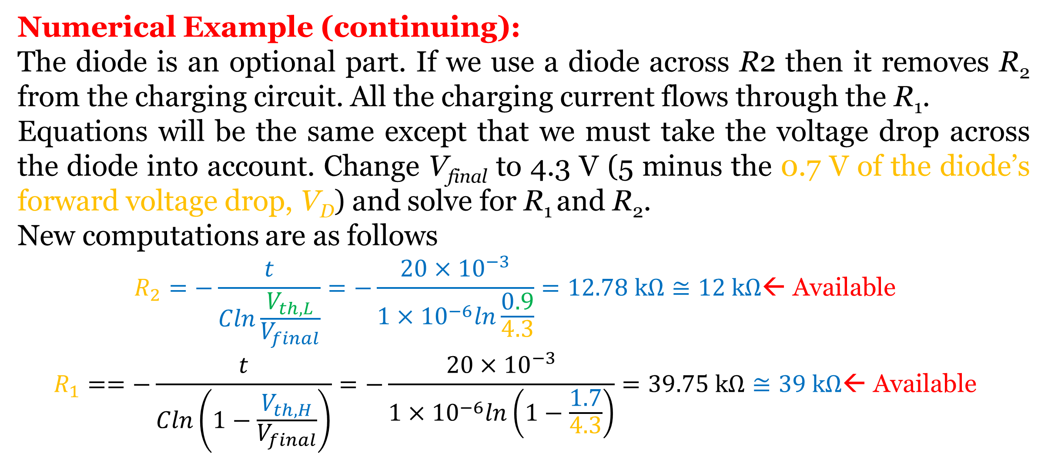
Hardware Debouncing
Numerical Example (continuing):
The diode is an optional part. If we use a diode across R2 then it removes R₂ from the charging circuit. All the charging current flows through the R₁.
Equations will be the same except that we must take the voltage drop across the diode into account. Change V_{final} to 4.3 V (5 minus the 0.7 V of the diode’s forward voltage drop, V_{D}) and solve for R₁ and R₂.
New computations are as follows
$$R_{2}=−\frac{t}{Cln\frac{V_{th,L}}{V_{final}}}=−\frac{20×{10}^{−3}}{1×{10}^{−6}ln\frac{0.9}{4.3}}=12.78 kΩ≅12 kΩ\text{← }\text{Available}$$
$$R_{1}==−\frac{t}{Cln\left(1−\frac{V_{th,H}}{V_{final}}\right)}=−\frac{20×{10}^{−3}}{1×{10}^{−6}ln\left(1−\frac{1.7}{4.3}\right)}=39.75 kΩ≅39 kΩ\text{← }\text{Available}$$
Considering bounce times as 20 ms and capacitance value as 1 μF

Slide 24
Hardware Debouncing
Numerical Example (continuing):
Be wary of the components’ tolerances!
Standard resistors are usually ±5% (based on silver band as the 4th band on the resistor) to ±10% (based on gold band as the 4th band on the resistor), and the capacitors are ±20% (for electrolytic) to ±30% (for small ceramic capacitors) are error-prone from their nominal rating.
For example, if a resistor has nominal resistance value of 180 kΩ, and its 4th color band is silver color then the resistance value may vary between (180kΩ ± 5% of 180kΩ) i.e., from (180kΩ - 5% of 180kΩ) to (180kΩ + 5% of 180kΩ) or from (180 kΩ - 9kΩ) to (180 kΩ + 9kΩ) or from 171kΩ to 189kΩ.

Slide 25
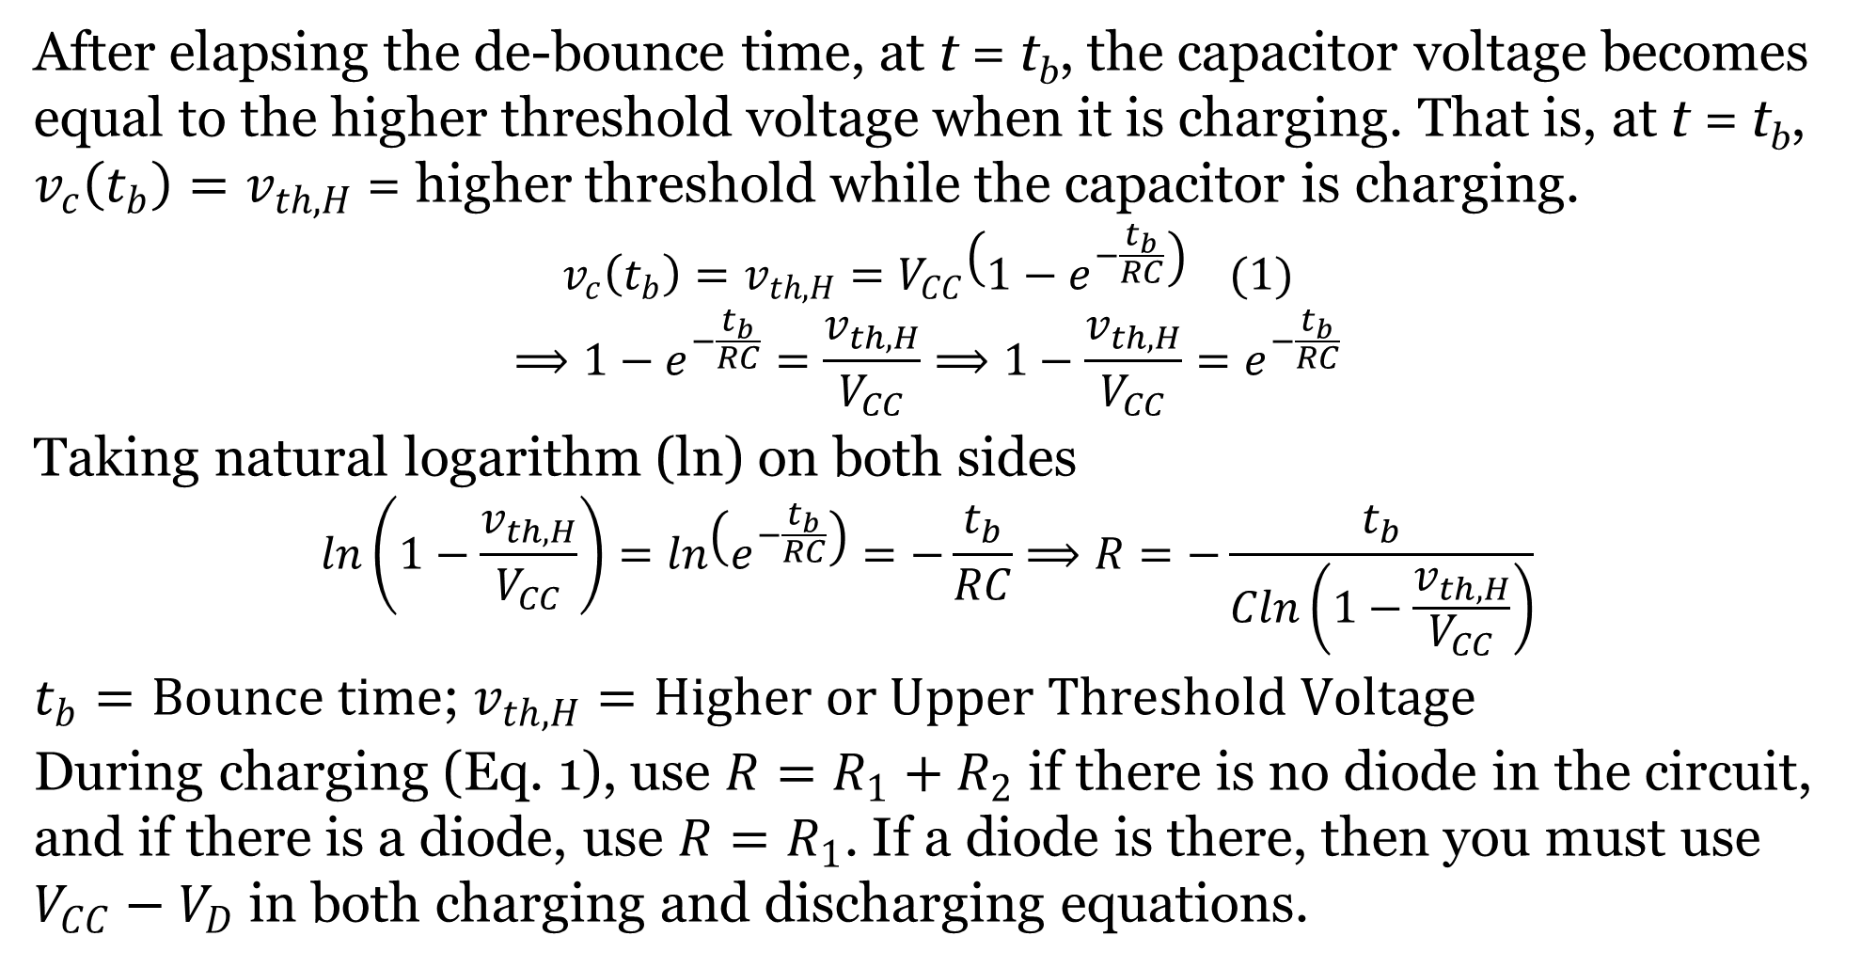

Hardware Debouncing (Summary)
After elapsing the de-bounce time, at t = t_{b}, the capacitor voltage becomes equal to the higher threshold voltage when it is charging. That is, at t = t_{b}, $v_{c}\left(t_{b}\right)=v_{th,H}$ = higher threshold while the capacitor is charging.
$$v_{c}\left(t_{b}\right)=v_{th,H}=V_{CC}\left(1−e^{−\frac{t_{b}}{RC}}\right) (1)$$
$$⟹1−e^{−\frac{t_{b}}{RC}}=\frac{v_{th,H}}{V_{CC}}⟹1−\frac{v_{th,H}}{V_{CC}}=e^{−\frac{t_{b}}{RC}}$$
Taking natural logarithm (ln) on both sides
$$ln\left(1−\frac{v_{th,H}}{V_{CC}}\right)=ln\left(e^{−\frac{t_{b}}{RC}}\right)=−\frac{t_{b}}{RC}⟹R=−\frac{t_{b}}{Cln\left(1−\frac{v_{th,H}}{V_{CC}}\right)}$$
$t_{b}=Bounce time$; $v_{th,H}=Higher or Upper Threshold Voltage$
During charging (Eq. 1), use $R=R_{1}+R_{2}$ if there is no diode in the circuit, and if there is a diode, use $R=R_{1}$. If a diode is there, then you must use $V_{CC}−V_{D}$ in both charging and discharging equations.
t = t_{b}
$$v_{th,H}$$

Slide 26

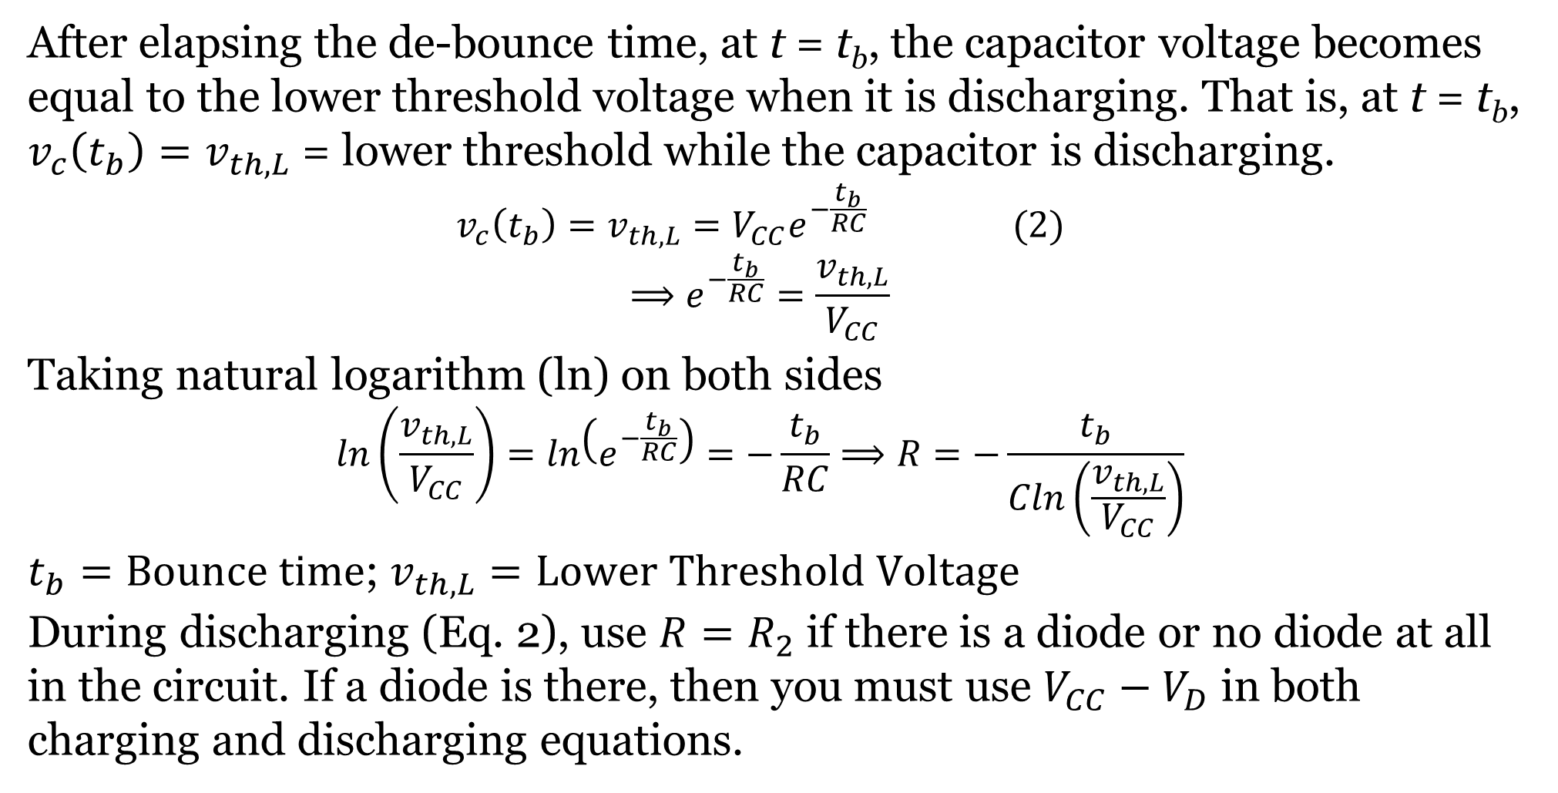
Hardware Debouncing (Summary)
After elapsing the de-bounce time, at t = t_{b}, the capacitor voltage becomes equal to the lower threshold voltage when it is discharging. That is, at t = t_{b}, $v_{c}\left(t_{b}\right)=v_{th,L}$ = lower threshold while the capacitor is discharging.
$$v_{c}\left(t_{b}\right)=v_{th,L}=V_{CC}e^{−\frac{t_{b}}{RC}} (2)$$
$$⟹e^{−\frac{t_{b}}{RC}}=\frac{v_{th,L}}{V_{CC}}$$
Taking natural logarithm (ln) on both sides
$$ln\left(\frac{v_{th,L}}{V_{CC}}\right)=ln\left(e^{−\frac{t_{b}}{RC}}\right)=−\frac{t_{b}}{RC}⟹R=−\frac{t_{b}}{Cln\left(\frac{v_{th,L}}{V_{CC}}\right)}$$
$t_{b}=Bounce time$; $v_{th,L}=Lower Threshold Voltage$
During discharging (Eq. 2), use $R=R_{2}$ if there is a diode or no diode at all in the circuit. If a diode is there, then you must use $V_{CC}−V_{D}$ in both charging and discharging equations.
t = t_{b}
$$v_{th,L}$$

Slide 27
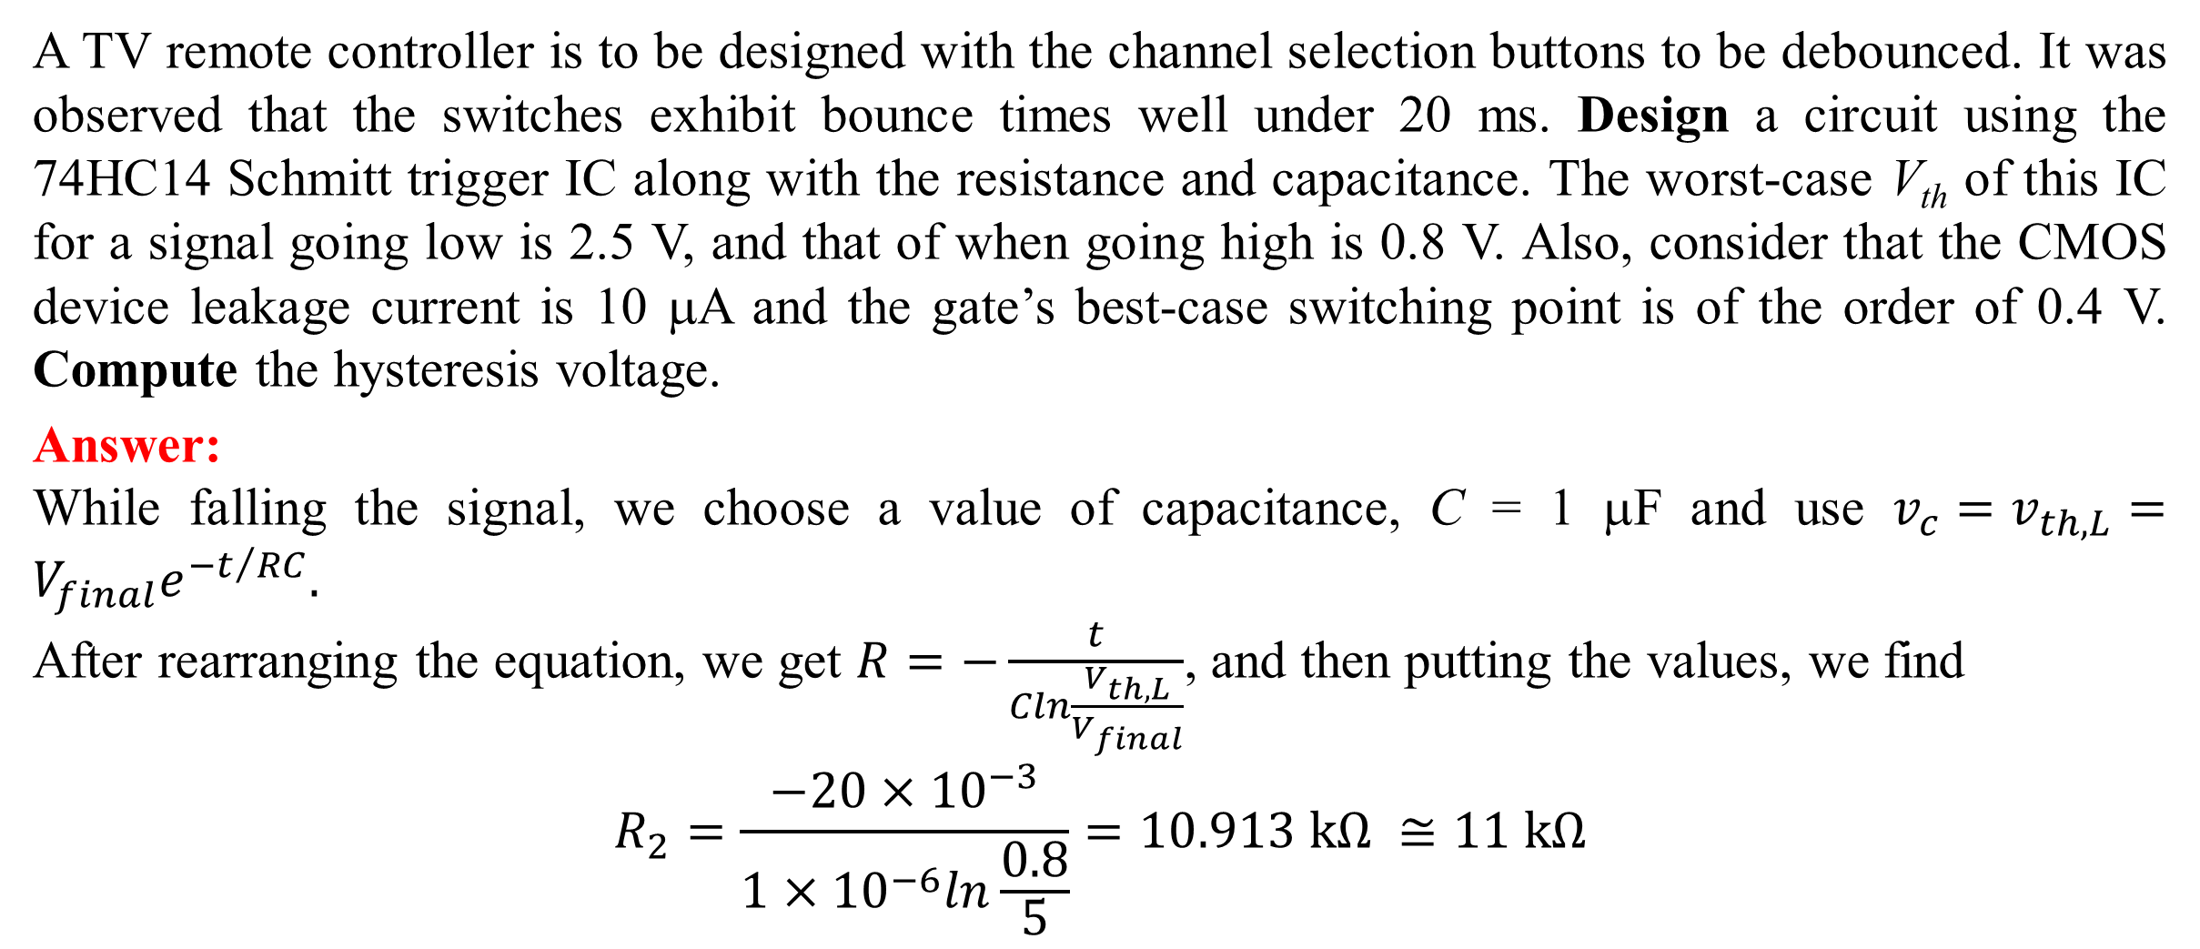
Example 2 on Debouncing
A TV remote controller is to be designed with the channel selection buttons to be debounced. It was observed that the switches exhibit bounce times well under 20 ms. Design a circuit using the 74HC14 Schmitt trigger IC along with the resistance and capacitance. The worst-case V_{th} of this IC for a signal going low is 2.5 V, and that of when going high is 0.8 V. Also, consider that the CMOS device leakage current is 10 μA and the gate’s best-case switching point is of the order of 0.4 V. Compute the hysteresis voltage.
Answer:
While falling the signal, we choose a value of capacitance, C = 1 μF and use $v_{c}=v_{th,L}=V_{final}e^{−t/{RC}}.$
After rearranging the equation, we get $R=−\frac{t}{Cln\frac{V_{th,L}}{V_{final}}}$, and then putting the values, we find
$$R_{2}=\frac{−20×{10}^{−3}}{1×{10}^{−6}ln\frac{0.8}{5}}=10.913 kΩ ≅11 kΩ$$
For TTL IC family, we usually choose supply voltage, V_{CC} = 5 V.

Slide 28
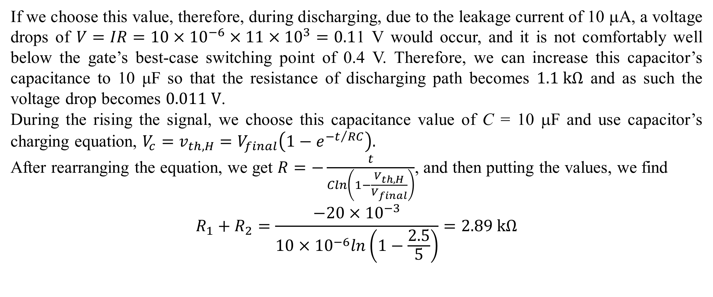
Example 2 on Debouncing
If we choose this value, therefore, during discharging, due to the leakage current of 10 μA, a voltage drops of $V=IR=10×{10}^{−6}×11×{10}^{3}=0.1$1 V would occur, and it is not comfortably well below the gate’s best-case switching point of 0.4 V. Therefore, we can increase this capacitor’s capacitance to 10 μF so that the resistance of discharging path becomes $1.1 kΩ$ and as such the voltage drop becomes $0.011 V$.
During the rising the signal, we choose this capacitance value of C = 10 μF and use capacitor’s charging equation, $V_{c}=v_{th,H}=V_{final}\left(1−e^{−t/{RC}}\right).$
After rearranging the equation, we get $R=−\frac{t}{Cln\left(1−\frac{V_{th,H}}{V_{final}}\right)}$, and then putting the values, we find
$$R_{1}+R_{2}=\frac{−20×{10}^{−3}}{10×{10}^{−6}ln\left(1−\frac{2.5}{5}\right)}=\text{2.89} kΩ$$

Slide 29

Example 2 on Debouncing
Since, already we have calculated R₂ = 1.1 kΩ, hence, R₁ = 2.89 – 1.1 = 1.79 kΩ $≅1.8 kΩ$. These values are available; therefore, we will use 1.1 kΩ for R₂ and 1.8 kΩ for R₁. Therefore, the final designed circuit is given as follows
The hysteresis voltage is given by
$$V_{H}=V_{th,H}−V_{th,L}=2.5−0.8=1.7 V$$

Slide 30
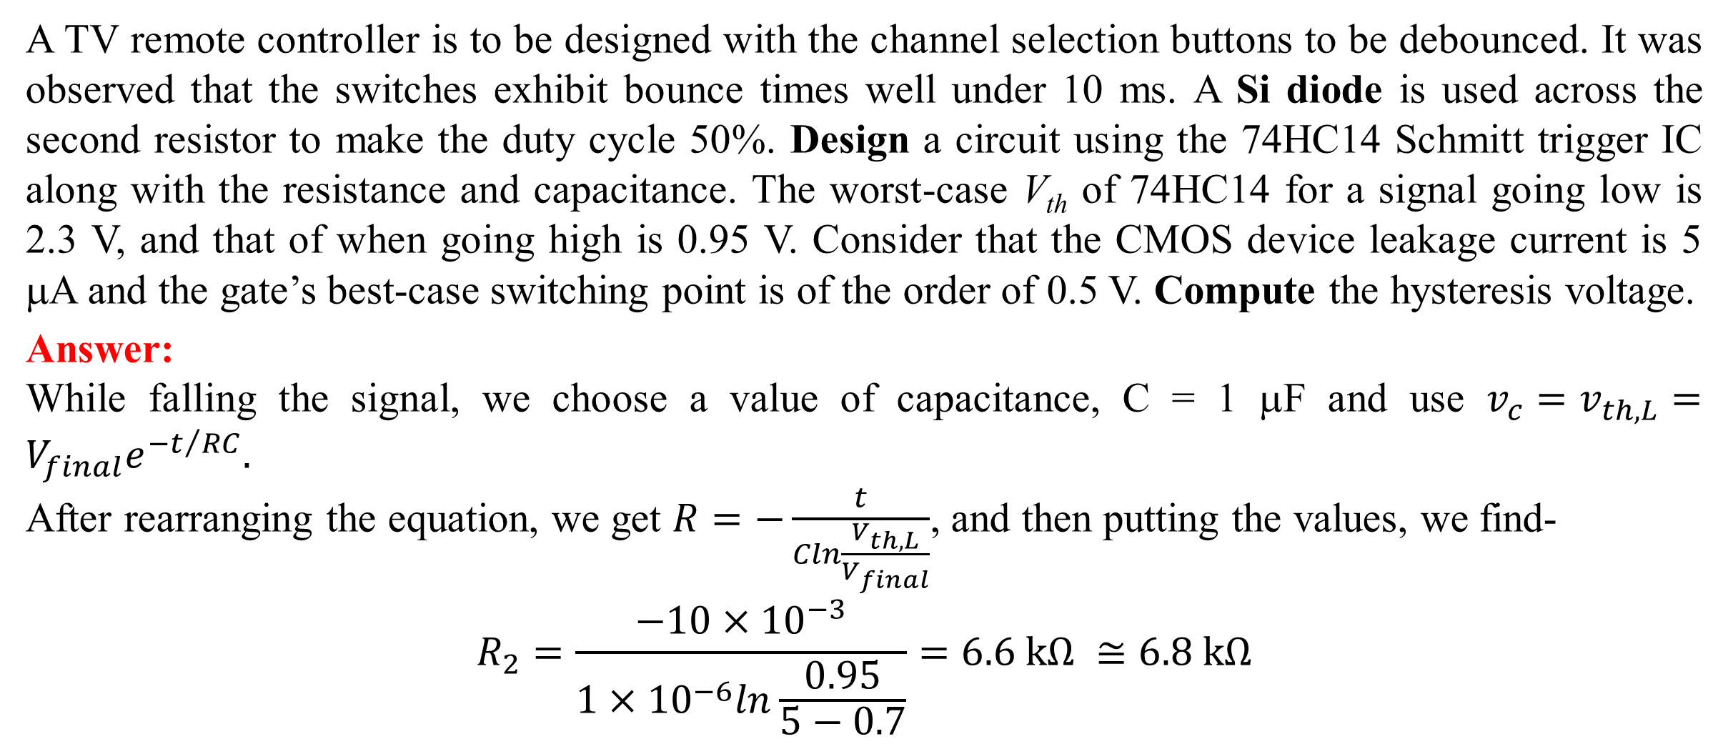
Example 3 on Debouncing
A TV remote controller is to be designed with the channel selection buttons to be debounced. It was observed that the switches exhibit bounce times well under 10 ms. A Si diode is used across the second resistor to make the duty cycle 50%. Design a circuit using the 74HC14 Schmitt trigger IC along with the resistance and capacitance. The worst-case V_{th} of 74HC14 for a signal going low is 2.3 V, and that of when going high is 0.95 V. Consider that the CMOS device leakage current is 5 μA and the gate’s best-case switching point is of the order of 0.5 V. Compute the hysteresis voltage.
Answer:
While falling the signal, we choose a value of capacitance, C = 1 μF and use $v_{c}=v_{th,L}=V_{final}e^{−t/{RC}}.$
After rearranging the equation, we get $R=−\frac{t}{Cln\frac{V_{th,L}}{V_{final}}}$, and then putting the values, we find-
$$R_{2}=\frac{−10×{10}^{−3}}{1×{10}^{−6}ln\frac{0.95}{5−0.7}}=6.6 kΩ ≅6.8 kΩ$$
For TTL IC family, we usually choose supply voltage, V_{CC} = 5 V.
Assuming the Si diode’s forward voltage drop, V_{D} = 0.7 V.

Slide 31
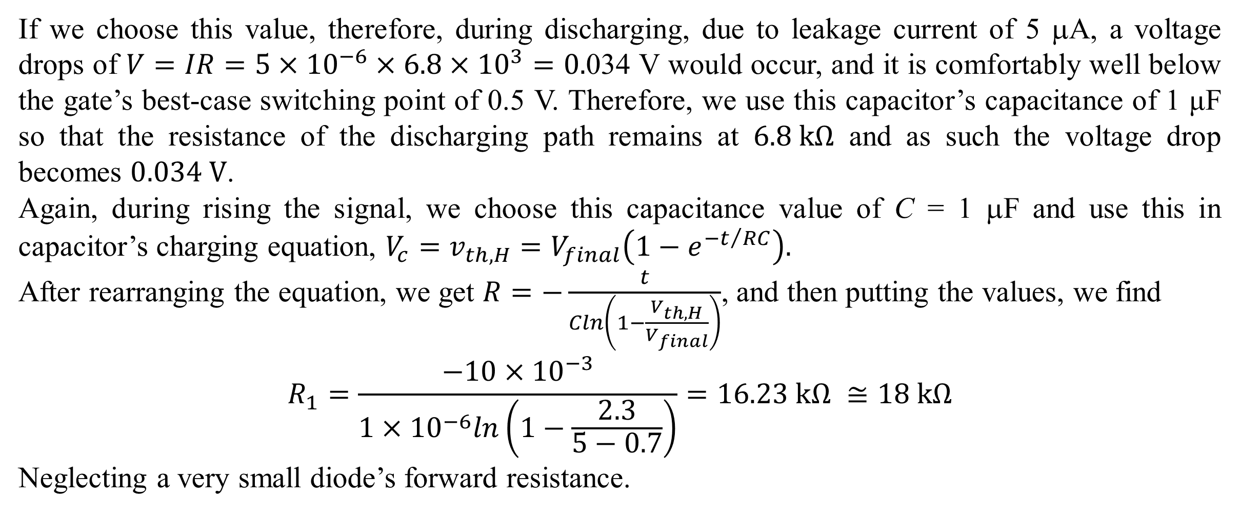
Example 3 on Debouncing
If we choose this value, therefore, during discharging, due to leakage current of 5 μA, a voltage drops of $V=IR=5×{10}^{−6}×6.8×{10}^{3}=0.$034 V would occur, and it is comfortably well below the gate’s best-case switching point of 0.5 V. Therefore, we use this capacitor’s capacitance of 1 μF so that the resistance of the discharging path remains at $6.8 kΩ$ and as such the voltage drop becomes $0.034 V$.
Again, during rising the signal, we choose this capacitance value of C = 1 μF and use this in capacitor’s charging equation, $V_{c}=v_{th,H}=V_{final}\left(1−e^{−t/{RC}}\right).$
After rearranging the equation, we get $R=−\frac{t}{Cln\left(1−\frac{V_{th,H}}{V_{final}}\right)}$, and then putting the values, we find
$$R_{1}=\frac{−10×{10}^{−3}}{1×{10}^{−6}ln\left(1−\frac{2.3}{5−0.7}\right)}=\text{16.23} kΩ ≅18 kΩ$$
Neglecting a very small diode’s forward resistance.
Assuming the Si diode’s forward voltage drop, V_{D} = 0.7 V.

Slide 32
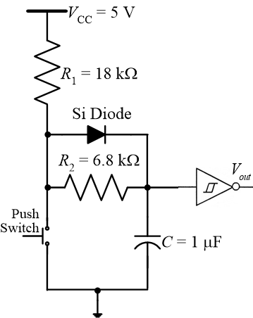

Example 3 on Debouncing
So, our calculated values for the designed circuit are R₁ = 18 kΩ, R₂ = 6.8 kΩ, and C = 1 μF. Therefore, the final designed circuit is given as follows
The hysteresis voltage is given by-
$$V_{H}=V_{th,H}−V_{th,L}=2.3−0.95=1.35 V$$

Slide 33
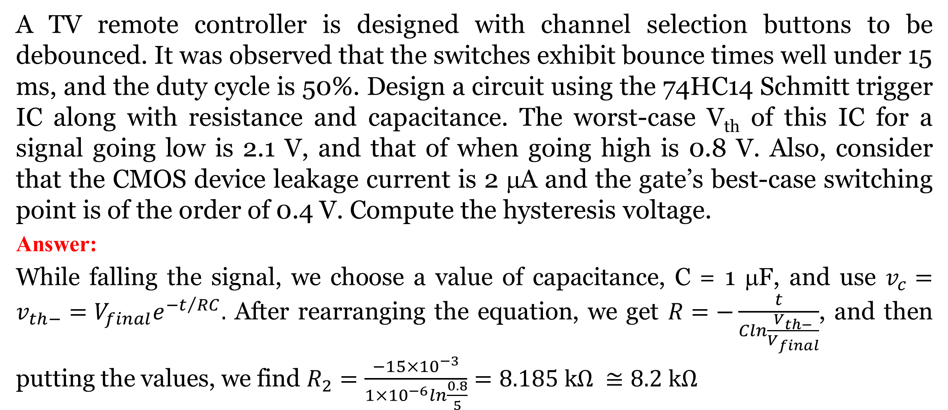
Example 4 on Debouncing
A TV remote controller is designed with channel selection buttons to be debounced. It was observed that the switches exhibit bounce times well under 15 ms, and the duty cycle is 50%. Design a circuit using the 74HC14 Schmitt trigger IC along with resistance and capacitance. The worst-case V_{th} of this IC for a signal going low is 2.1 V, and that of when going high is 0.8 V. Also, consider that the CMOS device leakage current is 2 μA and the gate’s best-case switching point is of the order of 0.4 V. Compute the hysteresis voltage.
Answer:
While falling the signal, we choose a value of capacitance, C = 1 μF, and use $v_{c}=v_{th−}=V_{final}e^{−t/{RC}}.$ After rearranging the equation, we get $R=−\frac{t}{Cln\frac{V_{th−}}{V_{final}}}$, and then putting the values, we find $R_{2}=\frac{−15×{10}^{−3}}{1×{10}^{−6}ln\frac{0.8}{5}}=8.185 kΩ ≅8.2 kΩ$
For TTL IC family, we usually choose supply voltage, V_{CC} = 5 V.

Slide 34
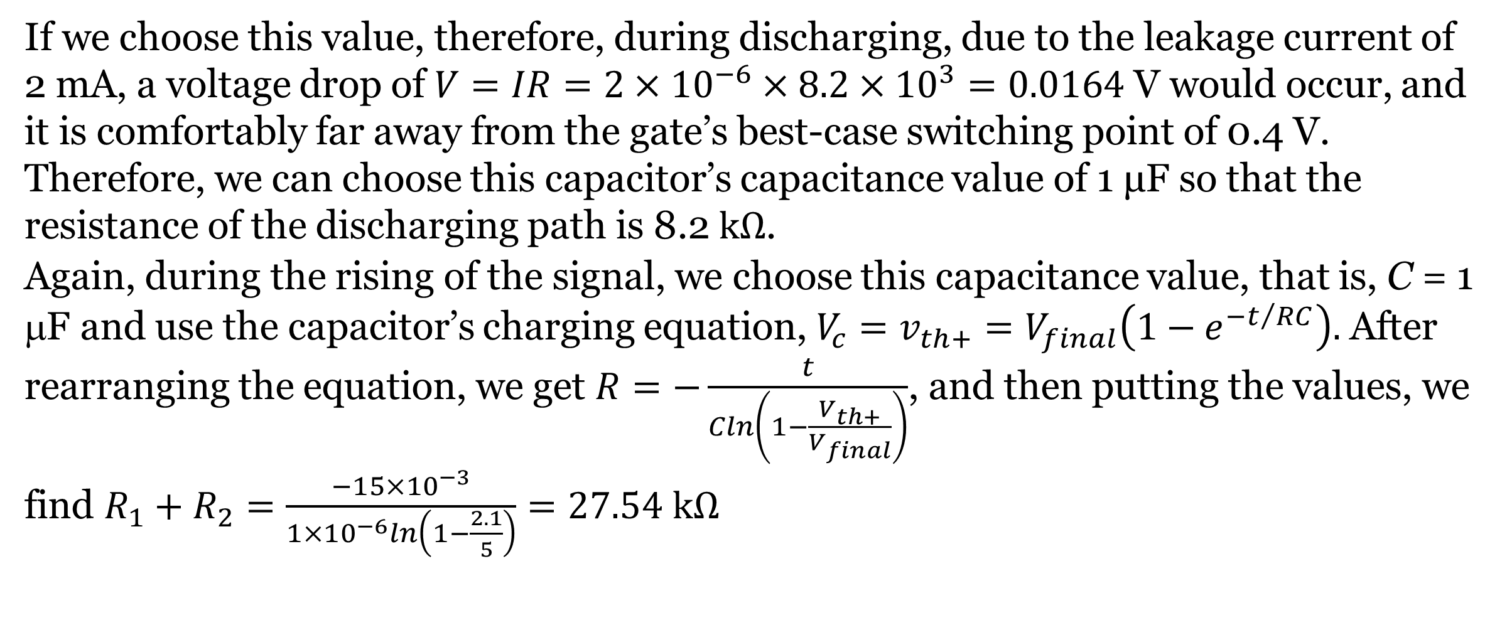
Example 4 on Debouncing
If we choose this value, therefore, during discharging, due to the leakage current of 2 mA, a voltage drop of $V=IR=2×{10}^{−6}×8.2×{10}^{3}=0.0164$ V would occur, and it is comfortably far away from the gate’s best-case switching point of 0.4 V. Therefore, we can choose this capacitor’s capacitance value of 1 μF so that the resistance of the discharging path is 8.2$kΩ$.
Again, during the rising of the signal, we choose this capacitance value, that is, C = 1 μF and use the capacitor’s charging equation, $V_{c}=v_{th+}=V_{final}\left(1−e^{−t/{RC}}\right).$ After rearranging the equation, we get $R=−\frac{t}{Cln\left(1−\frac{V_{th+}}{V_{final}}\right)}$, and then putting the values, we find $R_{1}+R_{2}=\frac{−15×{10}^{−3}}{1×{10}^{−6}ln\left(1−\frac{2.1}{5}\right)}=27.54 kΩ$

Slide 35

Example 4 on Debouncing
Since, already we have calculated R₂ = 8.2 kΩ, hence, R₁ = 27.54 – 8.2 = 19.34 kΩ $≅20 kΩ$. Therefore, the final designed circuit is given as follows
The hysteresis voltage is given by
$V_{H}=V_{th+}−V_{th−}=2.1−0.8=1.3$ V

Slide 36
Software Debouncing
Debouncing in hardware may give rise to additional cost, and it is more difficult to determine a good debouncing for all the push button switches that will be used. So, it may be preferable to debounce the switch in software.
Debouncing a switch in software is very simple. The basic idea is to sample the switch signal at a regular interval and filter out any glitches. There are a couple of approaches to achieving this. These approaches assume a switch circuit like that shown in the explanation of switch bounce- a simple push switch with a pull-up resistor.
While numerous algorithms exist to perform the debouncing function, we are going to limit ourselves to implementing two during the lab. Both approaches use a timer.

Slide 37
Software Debouncing
Approach 1
The first approach uses a counter to time how long the switch signal has been low. If the signal has been low continuously for a set amount of time, then it is considered pressed and stable.
1 Setup a counter variable, initialized to zero.
2 Setup a regular sampling event, perhaps using a timer. Use a period of about 1 ms.
3 On a sample event:
4 if the switch signal is HIGH then
5 RESET the counter variable to ZERO
6 SET internal switch state to released
7 else
8 Increment the counter variable to a maximum of 10
9 end if
10 if counter=10 then
11 SET internal switch state to pressed
12 end if

Slide 38
Software Debouncing
Approach 2
The second approach is like the first but uses a shift register instead of a counter. The algorithm assumes an unsigned 8-bit register value, such as that found in 8-bit microcontrollers.
1 Set up a variable to act as a shift register and initialize it to 0xFF.
2 Set up a regular sampling event, perhaps using a timer. Use a period of about 1 ms.
3 On a sample event:
4 SHIFT the variable towards the most significant bit
5 SET the least significant bit to the current switch value
6 if shift register value = 0 then
7 SET internal switch state to pressed
8 else
9 SET internal switch state to released
10 end if

Slide 39
Software Debouncing
There are two more approaches to software debouncing.
In the first technique, wait for a switch closure, then test the switch again after a short delay (15 ms or so). If it is still closed, detect that the switch has changed state.
In the second technique, check the switch state periodically to see if it has changed its state.
When working with microcontrollers, we can deal with switch bounce in a different way that may save both hardware, space, and money. Some programmers do not care much about bouncing switches and just add a 50 ms delay after the first bounce. This forces the microcontroller to wait 50 ms for the bouncing to stop, and then continue with the program. This is not a good practice, as it keeps the microcontroller waiting.
Another way is to use an interrupt for handling the switch bounce. Be aware that the interrupt might be fired on both the rising and falling edge, and some microcontrollers might stack up one waiting interrupt.

Slide 40
Software Debouncing
The following is a simple software debounce code for Arduino written in IDE
int inPin = 7; // the pin number of the input pin
int outPin = 13; // the pin number of the output pin
int counter = 0; // how many times we have seen new value
int reading; // the current value read from the input pin
int current_state = LOW; // the debounced input value
// the following variable is a long because the time, measured in milliseconds,
// will quickly become a bigger number than can be stored in an int.
long time = 0; // the last time the output pin was sampled
int debounce_count = 10; // number of millisecond/samples to consider before declaring a debounced input
void setup()
{
pinMode(inPin, INPUT);
pinMode(outPin, OUTPUT);
digitalWrite(outPin, current_state); // setup the Output LED for initial state
}

Slide 41
void loop()
{
// If we have gone on to the next millisecond
if(millis() != time)
{
reading = digitalRead(inPin);
if(reading == current_state && counter > 0)
{
counter--;
}
if(reading != current_state)
{
counter++;
}
// If the Input has shown the same value for long enough let's switch it
if(counter >= debounce_count)
{
counter = 0;
current_state = reading;
digitalWrite(outPin, current_state);
}
time = millis();
}
}
millis () function:
This function is used to return the number of milliseconds at the time, the Arduino board begins running the current program, that is, this Arduino function returns the present time in milliseconds from the moment the Arduino board is powered on or reset. The return value of millis is the number of milliseconds through an unsigned long variable since the program in Arduino started.
This number overflows i.e., goes back to zero after approximately 50 days.
millis() function Syntax. millis(); This function returns milliseconds from the start of the program.

Slide 42
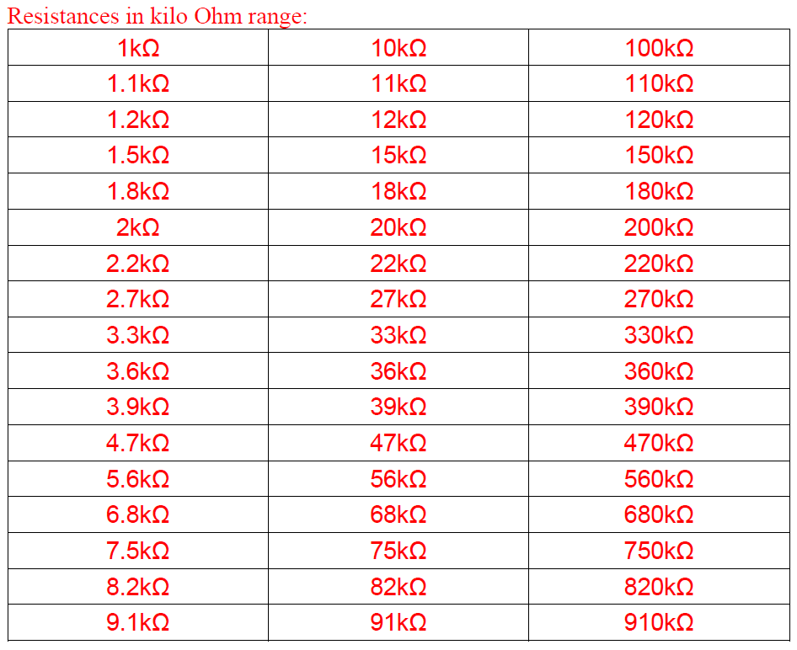
Standard Values of Resistance (Commercially Available in the Market):

Slide 43
References
ATMega328 manual
http://www.ganssle.com/debouncing-pt2.htm
https://mansfield-devine.com/speculatrix/ 2018/04/debouncing-fun-with-schmitt-triggers-and-capacitors/

Slide 44
Thanks for Attending….
?

